Slide 1

Carpal Tunnel Syndrome
By Jacob Watson for ICS3U

Slide 2
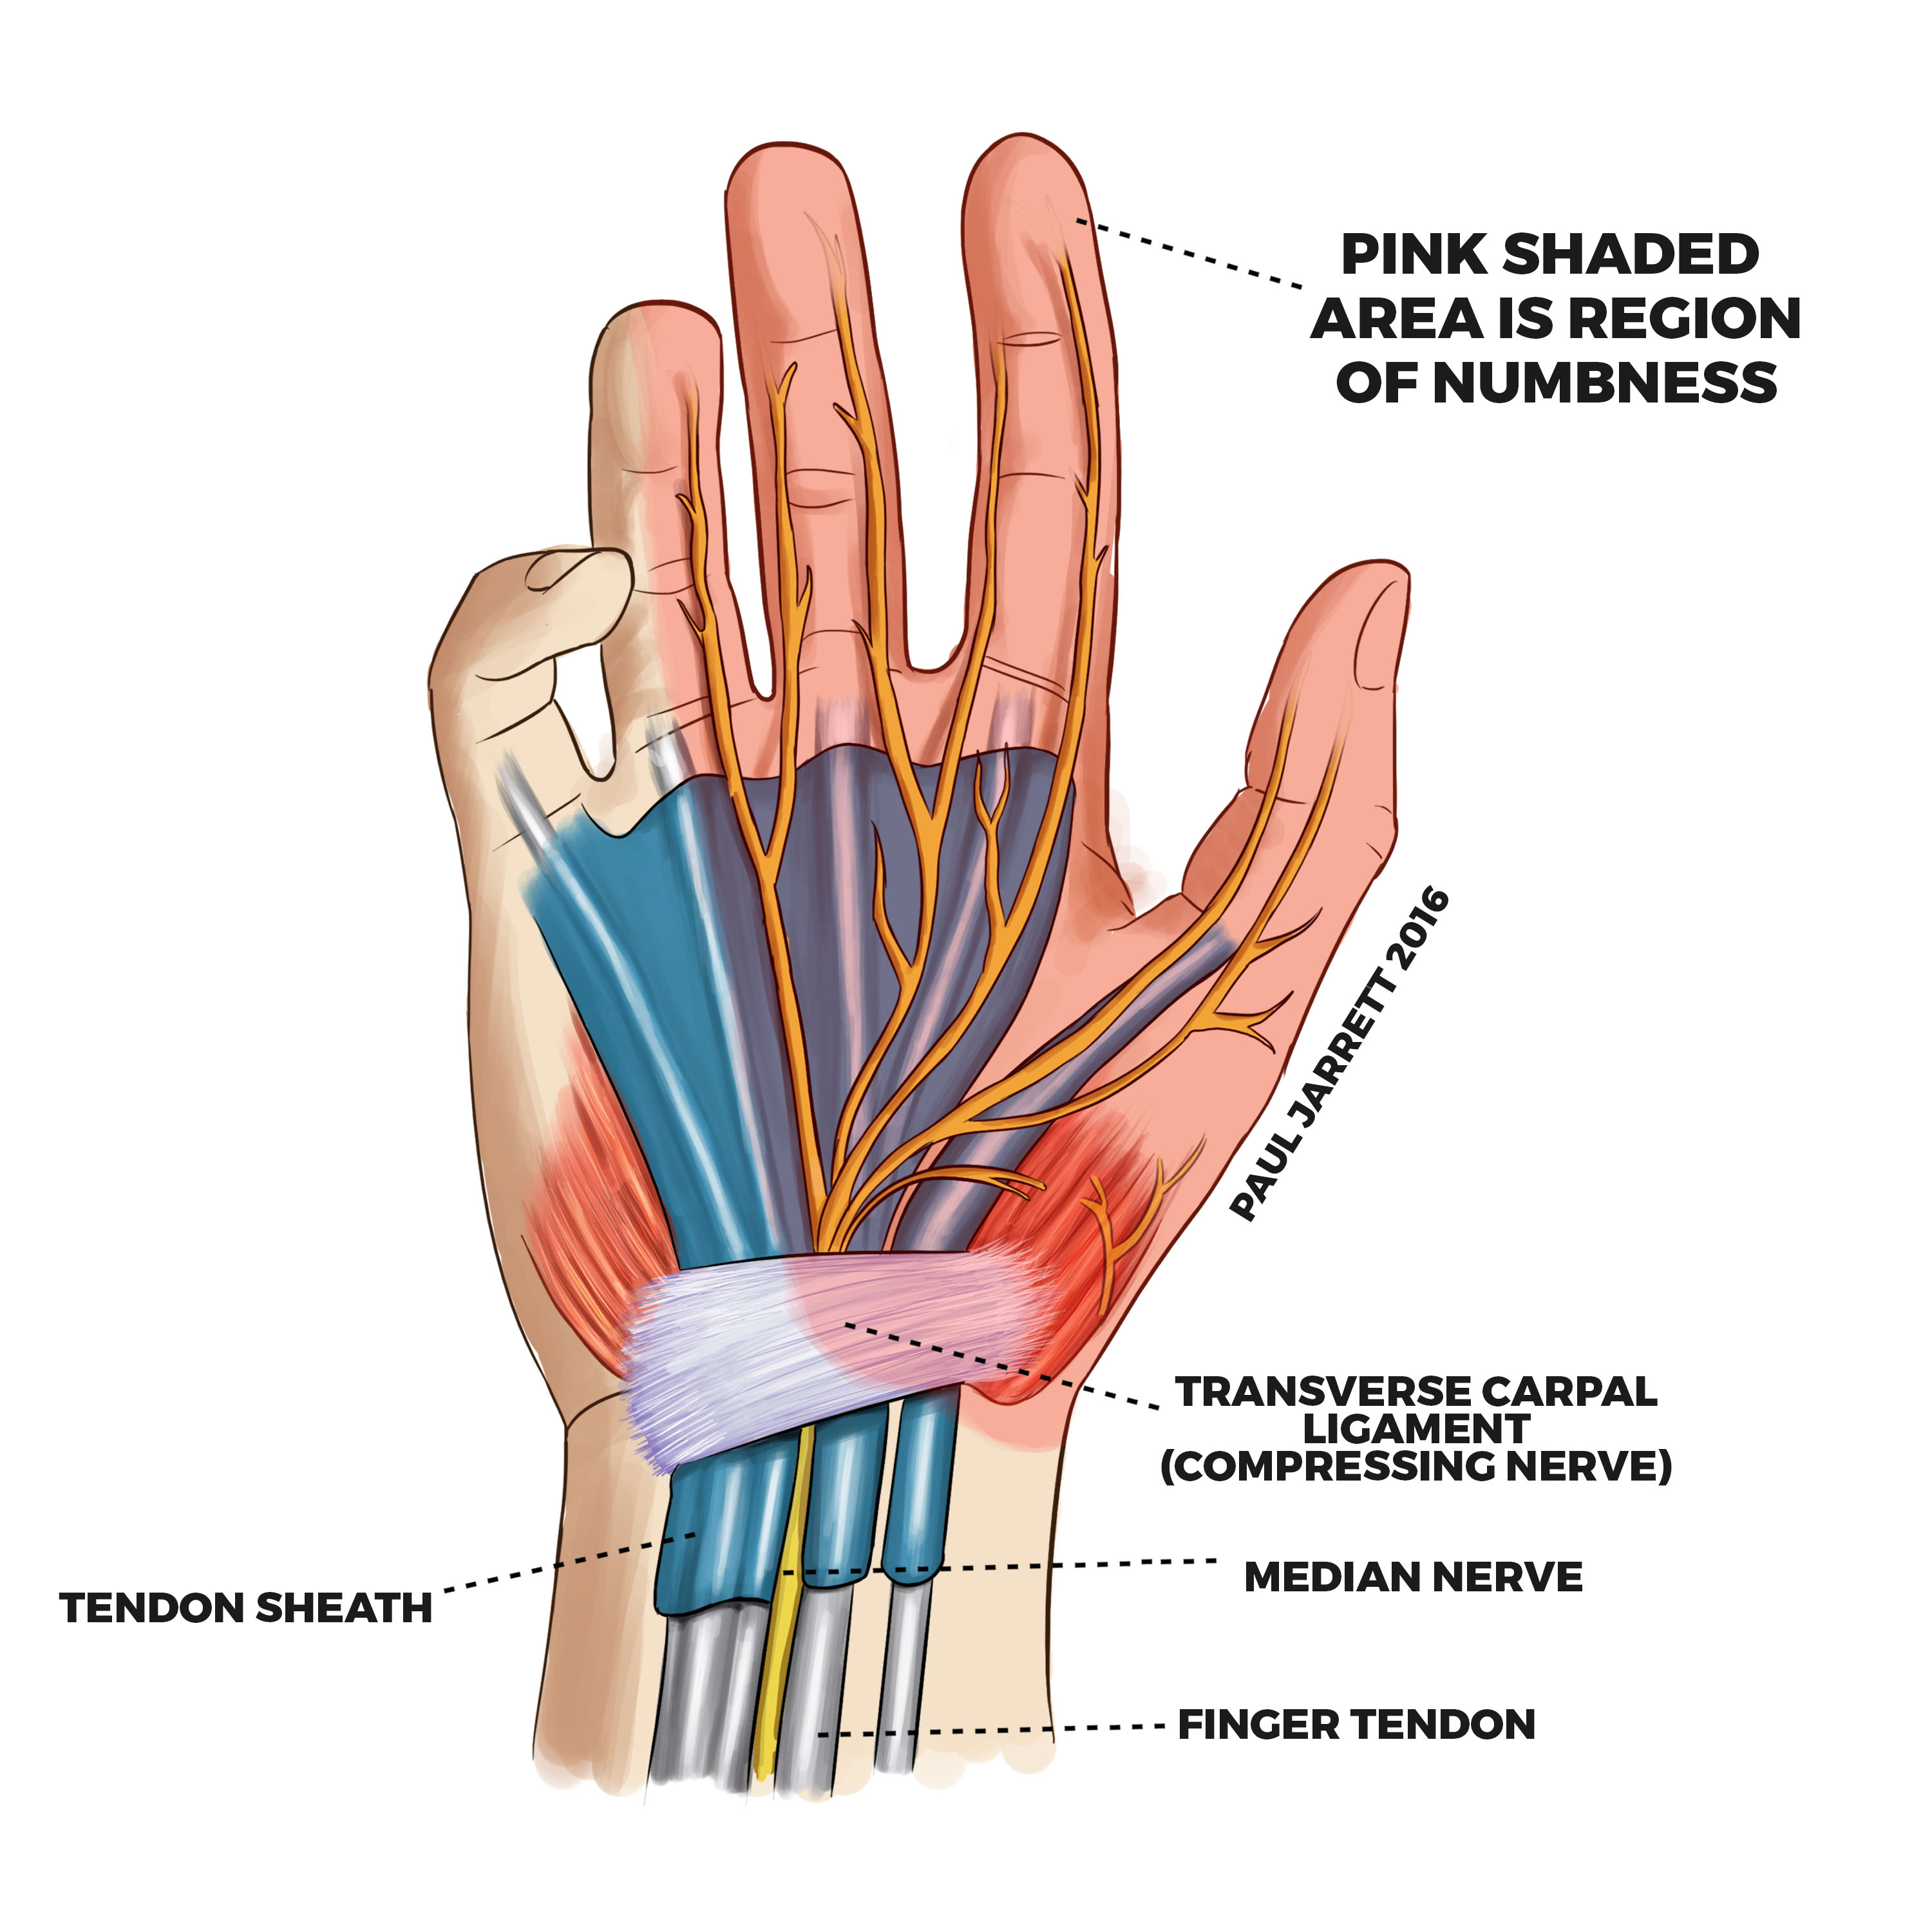
Carpal Tunnel Syndrome
Carpal tunnel syndrome is numbness, tingling or weakness due to pressure on the median nerve. The median nerve travels through the carpal tunnel; a narrow passageway located on the palm side of the hand, which is surrounded by bones and ligaments.

Slide 3

Prevalence
Carpal tunnel syndrome causes up to $2 000 000 000 per year in medical costs in the USA and it causes an employee to miss an average of 27 days of work.

Slide 4
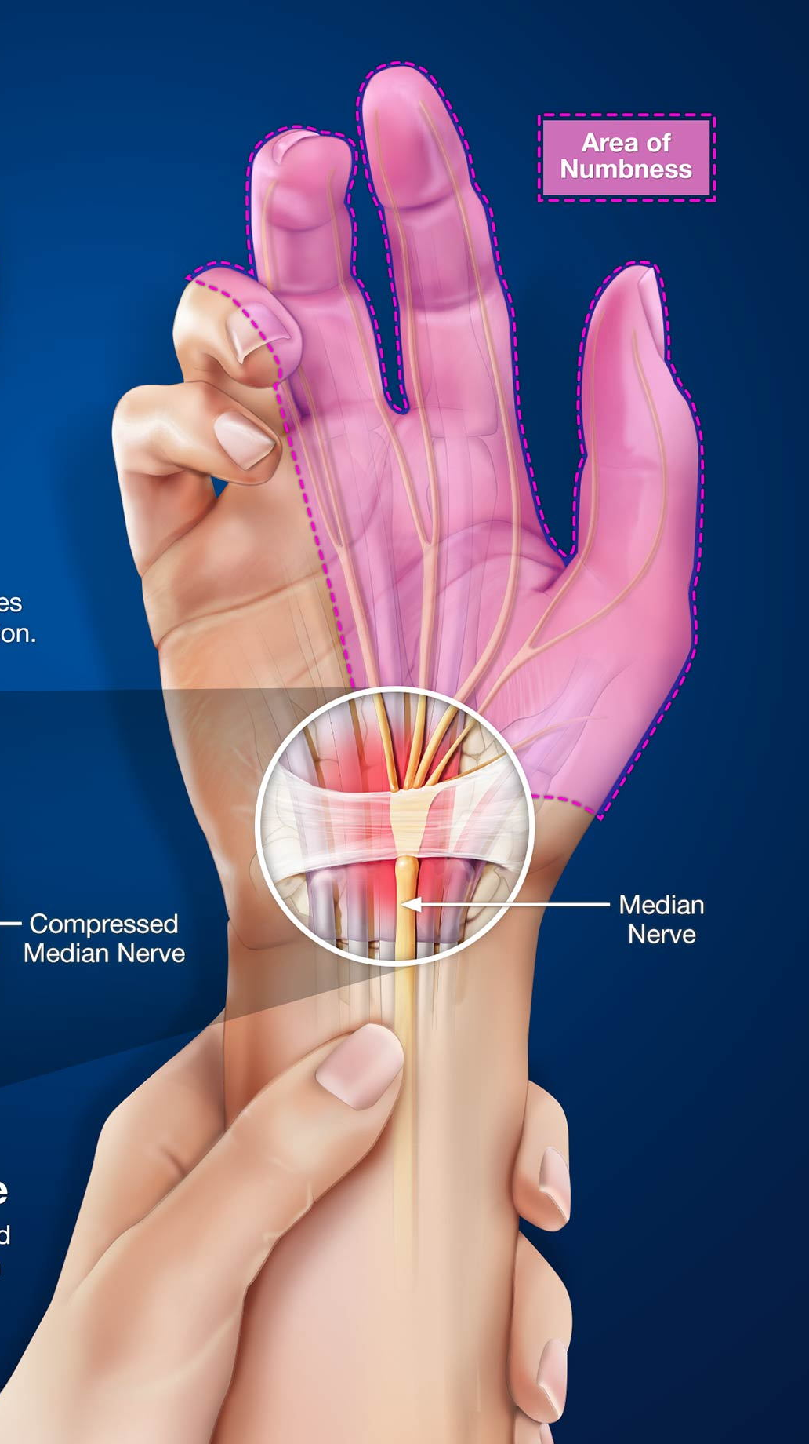
Process
When the tendons alongside the nerve become aggravated, they can swell, reducing the size of the carpal tunnel and putting pressure on the median nerve. This pressure causes tingling, numbness and weakness in the hand.

Slide 5

Causes
Carpal tunnel syndrome can be caused by hereditary features like your wrist anatomy, from repetitive hand movements like typing on a keyboard, and from prolonged placement of the wrist in extreme positions.

Slide 6

Symptoms
Symptoms of carpal tunnel syndrome include
Tingling or numbness in the index finger, middle finger, ring finger or thumb
Tingles may travel up the arm whilst holding an object.
Weakness in the hand, you may find that you are unable to hold objects, and end up dropping them

Slide 7

Diagnoses
Techniques for diagnosing carpal tunnel include looking at the patient's history of pain and doing a physical examination. The healthcare provider might also perform an ultrasound or a nerve conduction study; a test of the electrical conductivity of the median nerve through the carpal tunnel.

Slide 8

Treatment

Slide 9

Treatment
Carpal tunnel syndrome can be treatable, but it gets harder and harder to treat the more the symptoms progress. Make sure to reach out to a healthcare professional as soon as you notice symptoms start to appear.

Slide 10
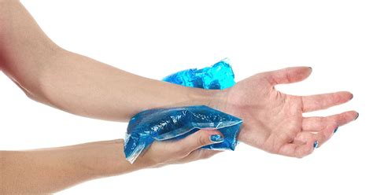
Self-Treatment
Some things you can try when the symptoms initial start are:
Take breaks to rest the hands more often
Apply ice-packs to the wrist to reduce swelling
Avoid doing things that make the symptoms worse

Slide 11

Non-Surgical Treatment
Treatment for carpal tunnel syndrome without surgery could include:
Wrist splints to support the wrist and prevent pain
Anti-inflammatory drugs to reduce swelling in the carpal tunnel
Steroids injected into the wrist to reduce swelling in the carpal tunnel

Slide 12

Surgery
If carpal tunnel syndrome has progressed far enough, surgery may be required, surgical treatments include:
Endoscopic surgery where a surgeon uses a “snake” with a camera to slice the ligament and free the median nerve
Open surgery where a surgeon makes an incision in the palm to slice the ligament and free the median nerve

Slide 13
Sources
https://www.mayoclinic.org/diseases-conditions/carpal-tunnel-syndrome/symptoms-causes/syc-20355603
https://orthoinfo.aaos.org/en/diseases--conditions/carpal-tunnel-syndrome/
https://www.verywellhealth.com/facts-about-carpal-tunnel-syndrome-5524726

